Slide 1
Software Testing
CIDM 4390 and 6330
Spring 2021
Credit to Dane Hillard “Practices of the Python Pro”

Slide 2
Testing
Anatomy of a Test
Various Testing Approaches
Writing Tests in Python (CIDM4390 uses C#)
Unittest
Pytest
xUnit
TDD

Slide 3
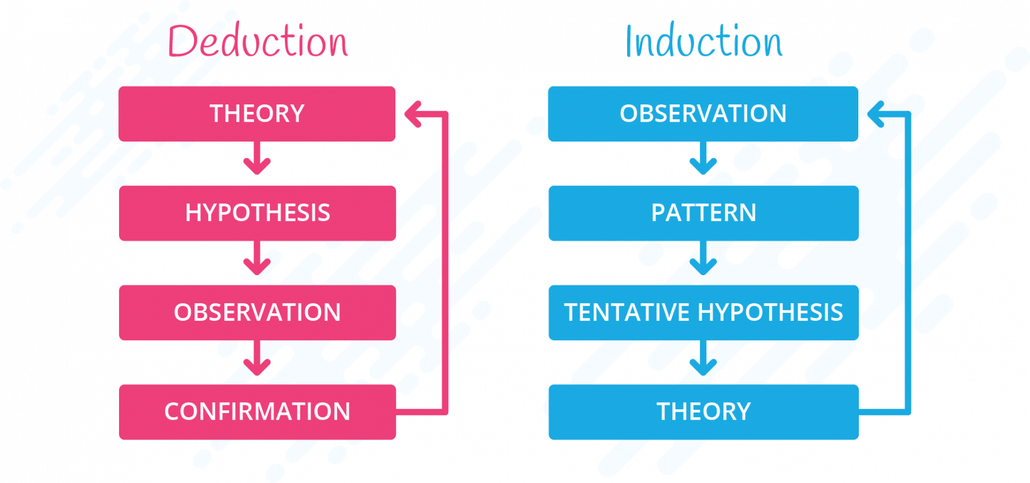
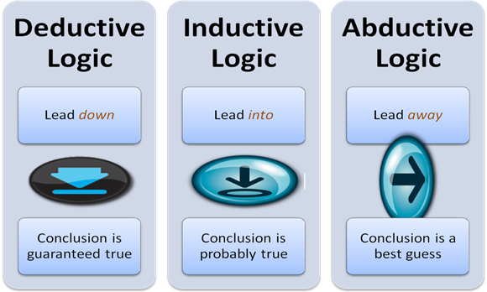
What is software testing?
Induction, Deduction, and Abduction
Conjecture vs. Proof
Validity
Discovery

Slide 4
In practice
Loosely speaking, software testing is the practice of verifying that software behaves the way you expect. (Hillard)
The most evident aspect of a system are its behaviors
Functional testing
Does it work the way it says it does?
Do my inputs have the desired/expected effects?
Are the outputs useful and meet expectations?

Slide 5
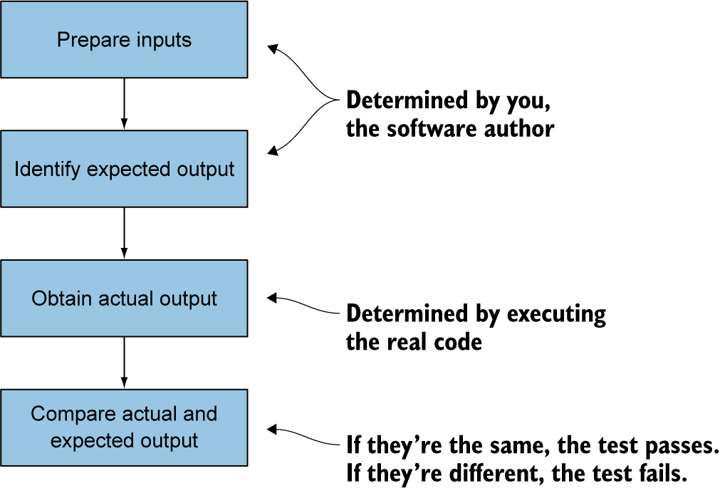
Functional Testing Recipe

Slide 6
Approaches to Functional Testing
Manual “does it break?” testing
Frail in nature
Humanly useful and necessary as supplement
Automated testing
Reliable
GIGO

Slide 7
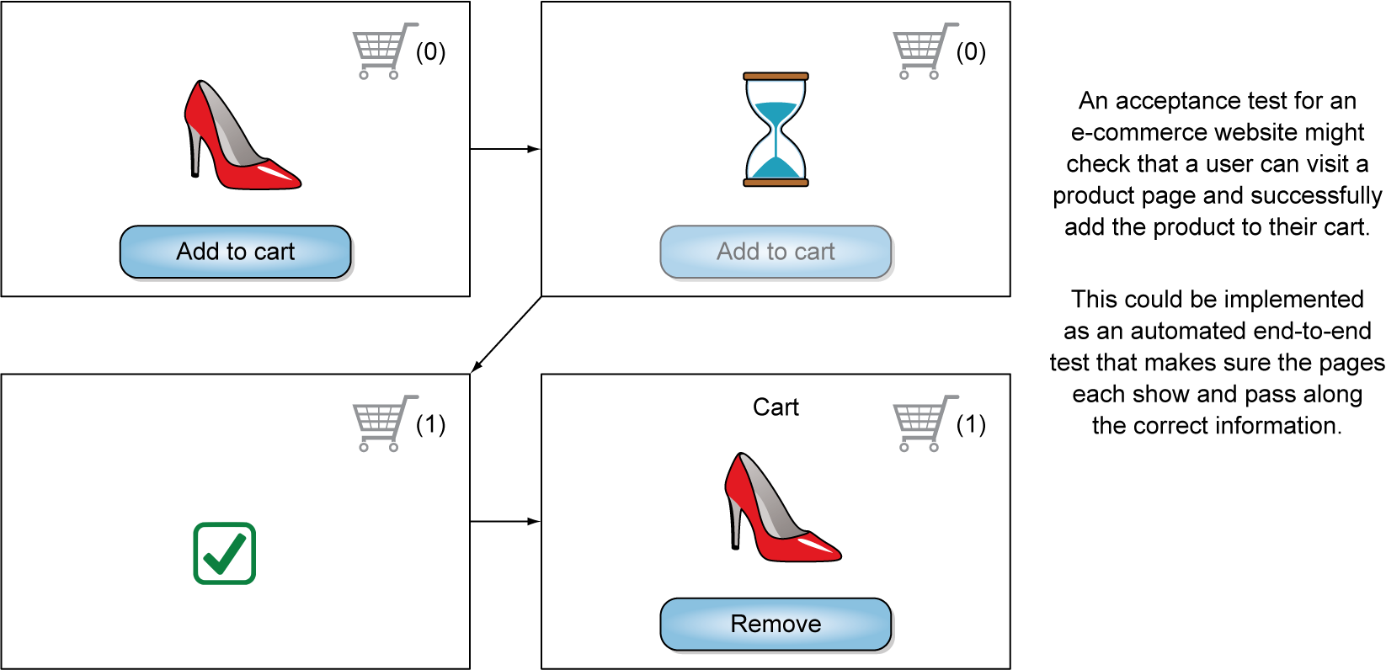
Workflows and Pathways
Acceptance Testing:
Verifies the high-level requirements of a system.
Deemed acceptable based on the specified requirements: acceptance tests answer questions like, “Can the user successfully go through the purchase workflow and buy the product they want?”

Slide 8
End to End Testing
Is the IPO clean?
BDD (Behavior Driven Development)
Holistic and Abstract and closer to an end-user’s evaluation framework
Example: https://cucumber.io/
BDD 101: https://cucumber.io/resources/ebooks/bdd-101-a-comprehensive-guide-to-behavior-driven-d/

Slide 9
Unit Testing
But does every piece work individually?
Automated testing of individual work and logic that constitutes the building blocks of your solution
Most important take-away and what will be honed in the course
Unit: (Hillard)
A unit is a small, fundamental piece of software… It’s a piece of code that can be isolated for testing.
Functions are generally considered units—they can be executed in isolation by calling them with the appropriate inputs.
Lines of code within those functions can’t be isolated, so they’re smaller than a unit.
Classes contain many pieces that can be isolated further, so they’re generally bigger than a unit, but they are occasionally treated as units

Slide 10
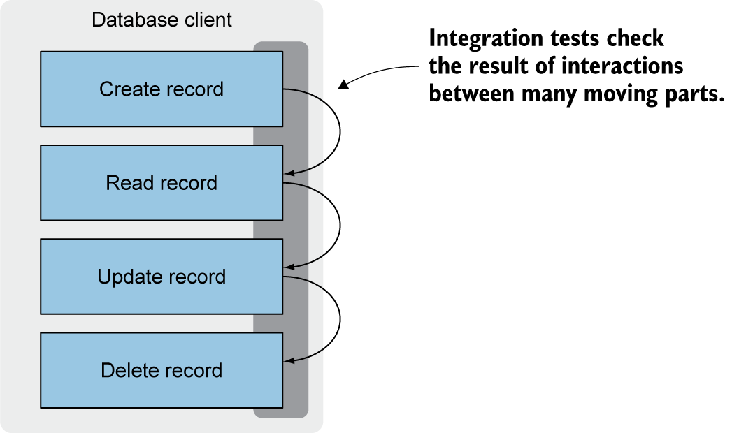
Integration Testing
Do the pieces fit together?
If so, has the overall behavior regressed?

Slide 11
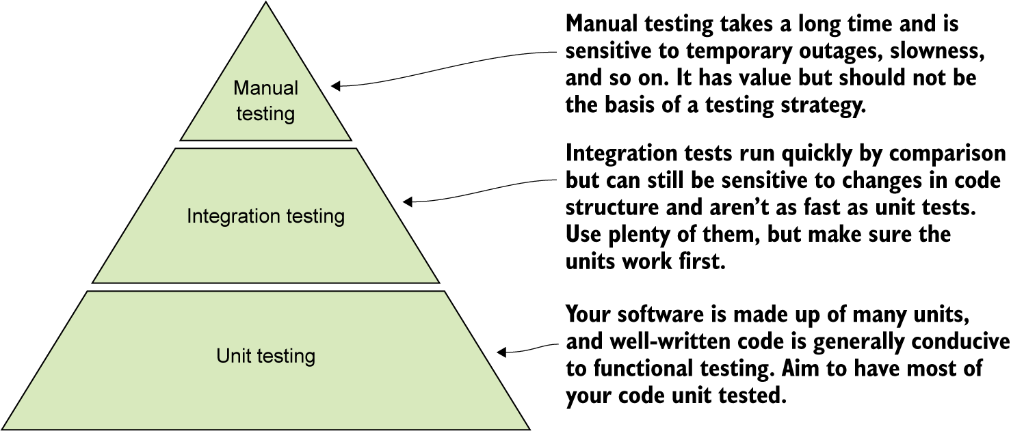
Testing Pyramid: Putting it all Together
Mike Cohn, Succeeding with Agile (Addison-Wesley Professional, 2009)

Slide 12
Entropy and Regression
As the system grows, your tests should forestall entropy
Your test suite will grow along with (and perhaps exponentially so) your code base.
They are intertwined.
Testing grows as your understanding of the problem and solution spaces grows
Eventually you work towards Continuous Integration
Explore more:
TravisCI: https://docs.travis-ci.com/user/for-beginners/
CircleCI: https://circleci.com/docs/

Slide 13
Assertions
Verify/Validate statements of Fact
The outcome of a test is NOT fuzzy
Implementations
Unittest – comes with Python
Pytest – a popular alternative
xUnit – popular for .NET

Slide 14
Unittest and Pytest
Integration Testing
Testing Data
Fakes - A system that behaves a lot like the real one, but avoids expensive or destructive actions
Stubs - Using a predetermined value as a response instead of getting one from a live system
Mocks - A system with the same interface as the real one, but that also records interactions for later inspection and assertions
Pytest is an alternative

Slide 15
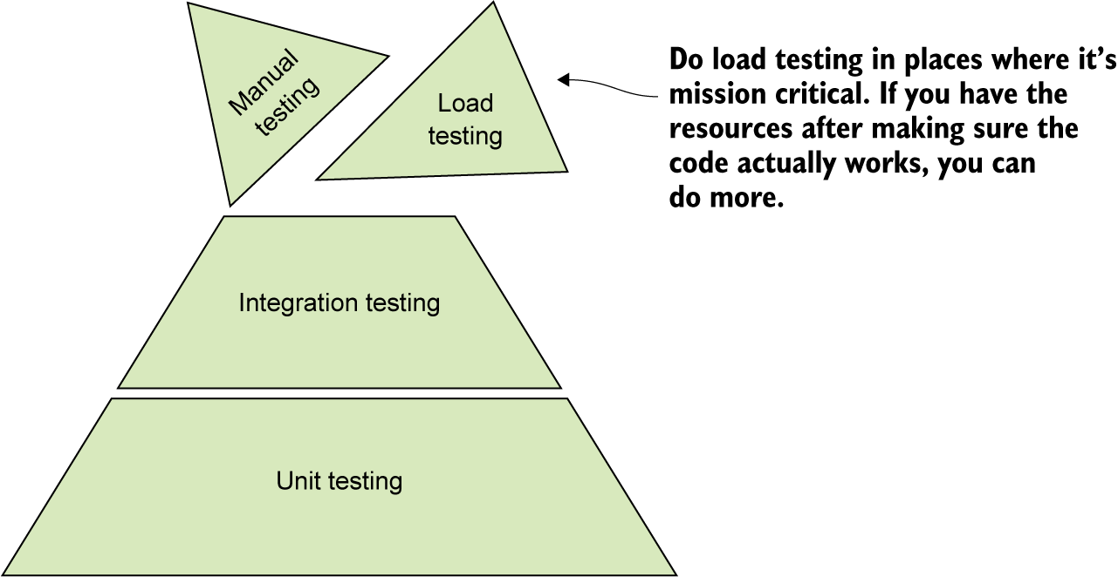
Beyond Functional Testing
Performance testing
Important “downstream” when understanding and learning pathways are clear
Do not prematurely optimize
As the scope and size of the application grows, this will become more important
Load testing

Slide 16
Towards TDD
Test-Driven Development is a mindset that holds that you implement a system by writing and fulfilling tests
Rather then the other way around
Start from Entropy and Failure
Refute it via proof
Coverage
Chaos Engineering: https://principlesofchaos.org/

Slide 17
Principles and Practice of Chaos
Start by defining ‘steady state’ as some measurable output of a system that indicates normal behavior.
Hypothesize that this steady state will continue in both the control group and the experimental group.
Introduce variables that reflect real world events like servers that crash, hard drives that malfunction, network connections that are severed, etc.
Try to disprove the hypothesis by looking for a difference in steady state between the control group and the experimental group.

Slide 18
Chaos vs. Tradition
Traditional
Chaos
Innocent until Proven Guilty
Engineer and tame chaos
A priori assumption on the connection between system function and system goals
Guilty until Proven Innocent
Assume and embrace change and chaos
Empirical discovery of the connection between system function and system goals

Slide 19
Summary
Functional tests make sure code produces the expected output from a given input.
Testing saves you time in the long run by catching bugs and making refactoring code easier.
Manual testing isn’t scalable and should be used to supplement automated testing.
Unittest and pytest are two popular unit and integration testing frameworks for Python.
Test-driven development puts the tests first, guiding you to a working implementation based on the requirements.

Slide 20
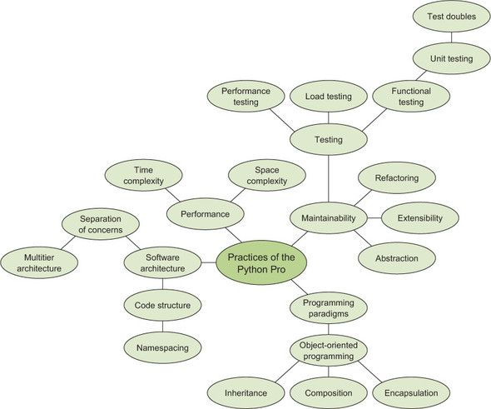
Hillard, Practices of the Python Pro – O’Reilly 2019

